Slide 1
FAUREL GEMA
IBM DATA SCIENCE PROFFESIONAL CERTIFICATION

Slide 2
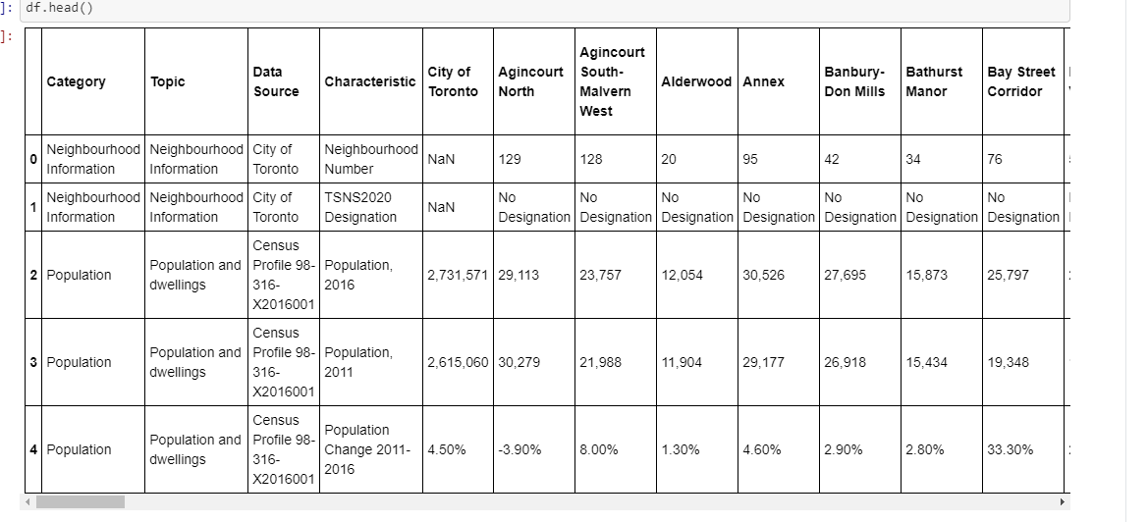
Data Sample

Slide 3
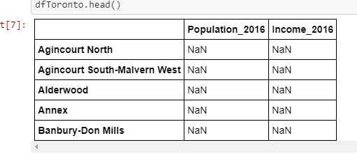
Collecting Population per neighborhood

Slide 4
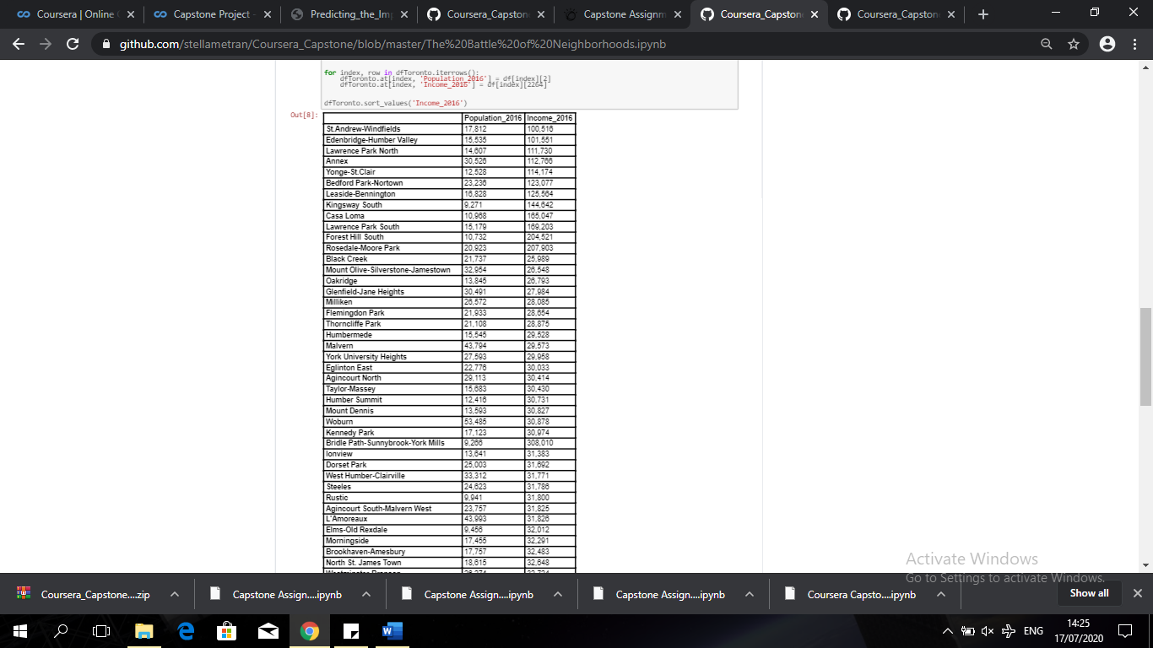
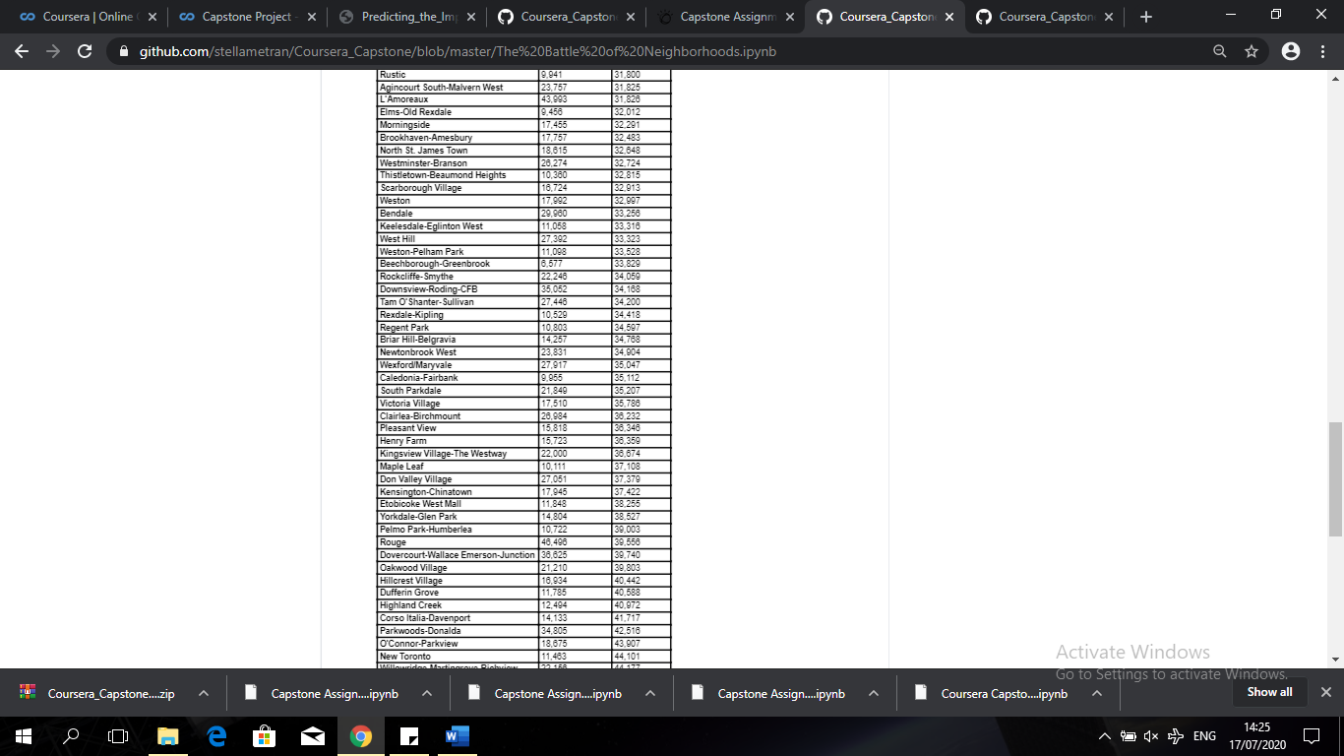
Populating the dataset with the data (In Progress)

